Slide 1
HOUSING PRICE PREDICTION
CHAMLIN NAJIR RAHMAN

Slide 2
PROBLEM STATEMENT
Housing and real estate market is one of the markets which is one of the major contributors in the world’s economy. It is a very large market and there are various companies working in the domain. Data science comes as a very important tool to solve problems in the domain to help the companies increase their overall revenue, profits, improving their marketing strategies and focusing on changing trends in house sales and purchases. Our problem is related to one such housing company.
A US-based housing company named Surprise Housing has decided to enter the Australian market. The company uses data analytics to purchase houses at a price below their actual values and flip them at a higher price. For the same purpose, the company has collected a data set from the sale of houses in Australia.
We are required to build a model using Machine Learning in order to predict the actual value of the prospective properties and decide whether to invest in them or not. For this company wants to know:
• Which variables are important to predict the price of variable?
• How do these variables describe the price of the house?

Slide 3
EDA STEPS
Exploratory Data Analysis.
Here we clean, analyze and visualize the given data, and then draw conclusions.
Step 1 : Importing the required libraries, like numpy, pandas, matplotlib and seaborn.
Step 2 : Importing the excel dataset into jupyter notebook.
Step 3 : Gather information about the dataset, like, columns, shape, datatype, null values, skewness, unique value count for each feature, statistical information using describe(), etc.

Slide 4
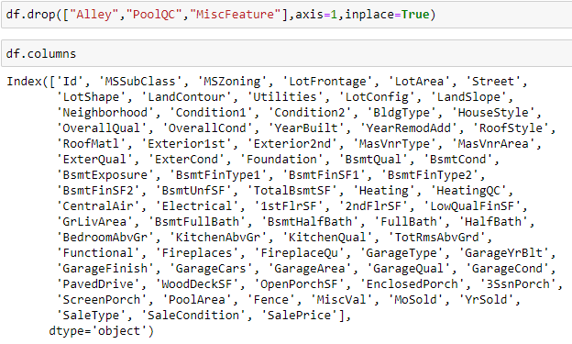
Dropping Columns :
"Alley", "PoolQC", "MiscFeature", has about 95% of null values, which is of no use to the machine learning models and hence can be dropped.

Slide 5
VISUALIZATIONS :
Countplot for univariate analysis.
Distribution plot for the continuos numeric columns.
Catplot for bivariate analysis of categorical data.
Lineplot for bivariate analysis of numeric data.
Boxplot to check for outliers present in the features.

Slide 6
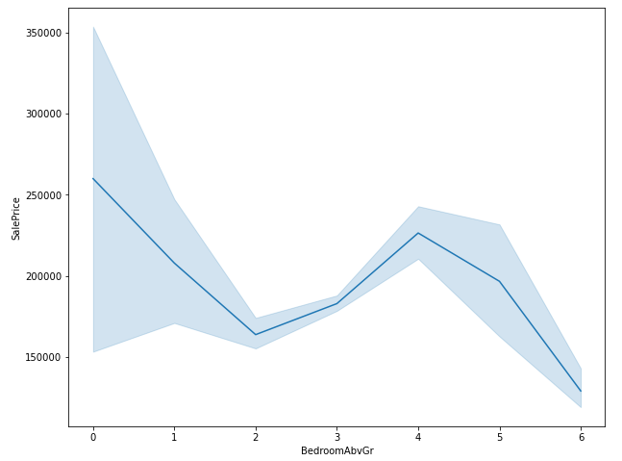
Example

Slide 7
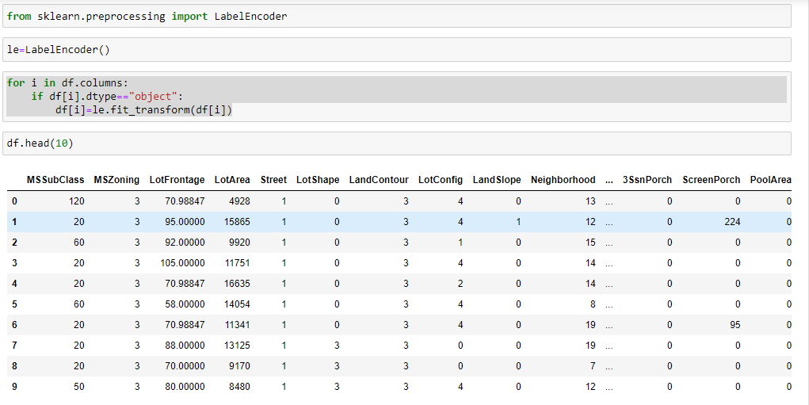
Label Encoder

Slide 8
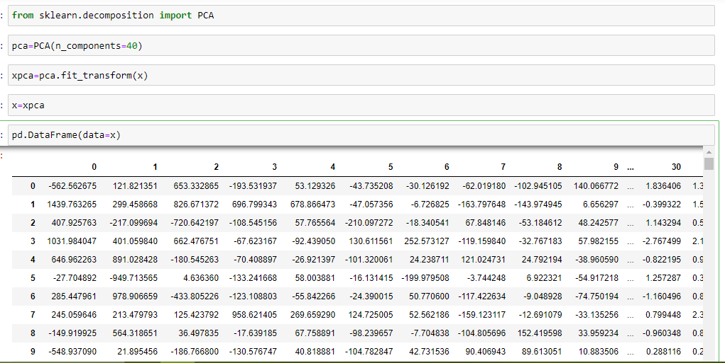
PCA(Principal Component Analysis)

Slide 9
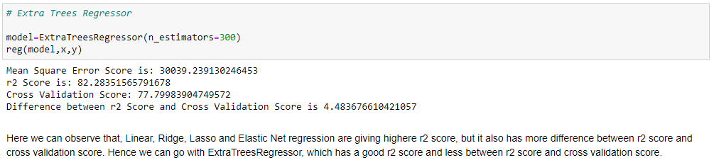
Best Model

Slide 10
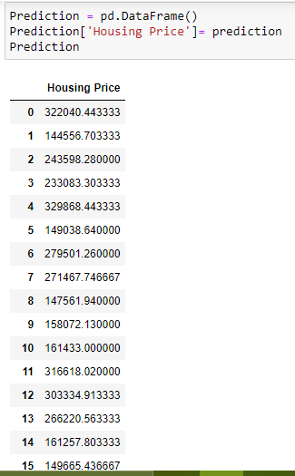
Predictions

